Slide 1
Automatic Speech Recognition

Slide 2
Automatic speech recognition
What is the task?
What are the main difficulties?
How is it approached?
How good is it?
How much better could it be?
<number>/34

Slide 3
What is the task?
Getting a computer to understand spoken language
By “understand” we might mean
  React appropriately
  Convert the input speech into another medium, e.g. text
Several variables impinge on this (see later)
<number>/34

Slide 4
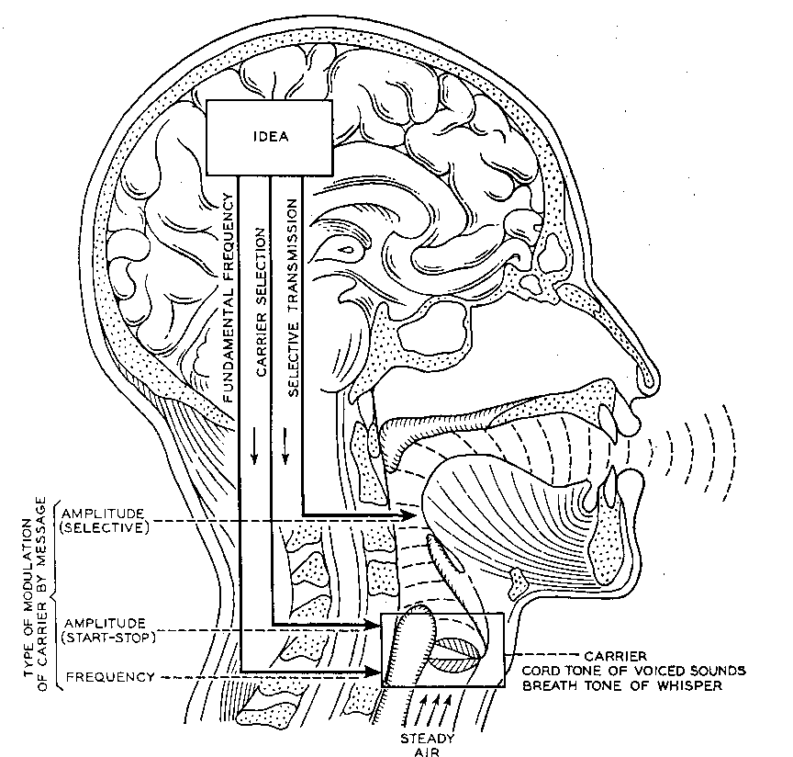
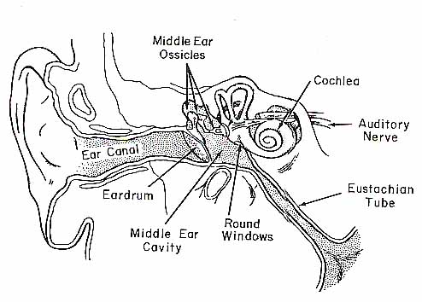

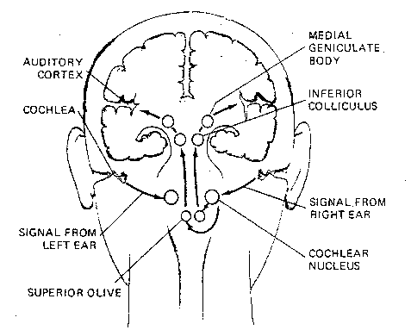
How do humans do it?
Articulation produces
sound waves which
the ear conveys to the brain
for processing
<number>/34

Slide 5
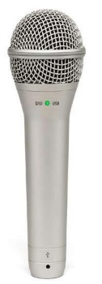
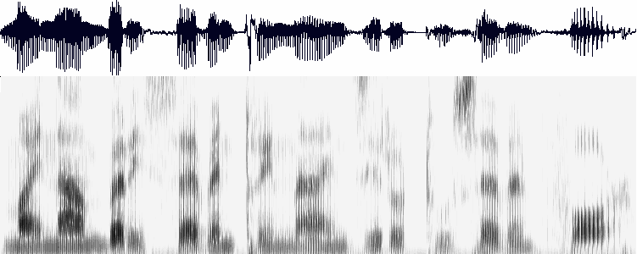
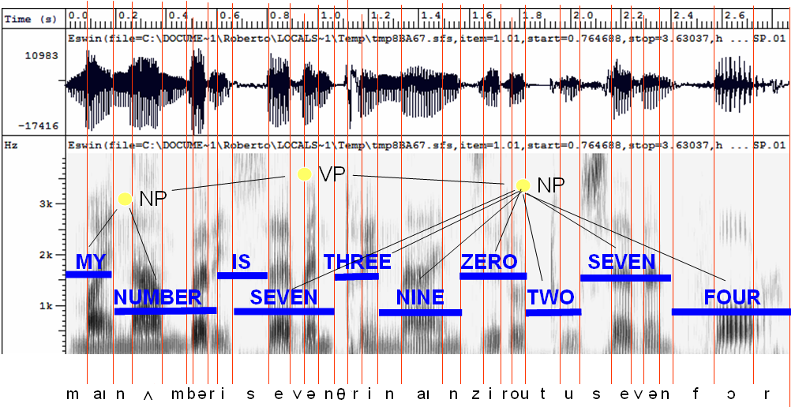
How might computers do it?
Acoustic waveform
Acoustic signal
Digitization
Acoustic analysis of the speech signal
Linguistic interpretation
Speech recognition
<number>/34

Slide 6
What’s hard about that?
Digitization
  Converting analogue signal into digital representation
Signal processing
  Separating speech from background noise
Phonetics
  Variability in human speech
Phonology
  Recognizing individual sound distinctions (similar phonemes)
Lexicology and syntax
  Disambiguating homophones
  Features of continuous speech
Syntax and pragmatics
  Interpreting prosodic features
Pragmatics
  Filtering of performance errors (disfluencies)
<number>/34

Slide 7
Digitization
Analogue to digital conversion
Sampling and quantizing
Use filters to measure energy levels for various points on the frequency spectrum
Knowing the relative importance of different frequency bands (for speech) makes this process more efficient
E.g. high frequency sounds are less informative, so can be sampled using a broader bandwidth (log scale)
<number>/34

Slide 8
Separating speech from background noise
Noise cancelling microphones
  Two mics, one facing speaker, the other facing away
  Ambient noise is roughly same for both mics
Knowing which bits of the signal relate to speech
  Spectrograph analysis
<number>/34

Slide 9
Variability in individuals’ speech
Variation among speakers due to
  Vocal range (f0, and pitch range – see later)
  Voice quality (growl, whisper, physiological elements such as nasality, adenoidality, etc)
  ACCENT !!! (especially vowel systems, but also consonants, allophones, etc.)
Variation within speakers due to
  Health, emotional state
  Ambient conditions
Speech style: formal read vs spontaneous
<number>/34

Slide 10
Speaker-(in)dependent systems
Speaker-dependent systems
  Require “training” to “teach” the system your individual idiosyncracies
    The more the merrier, but typically nowadays 5 or 10 minutes is enough
    User asked to pronounce some key words which allow computer to infer details of the user’s accent and voice
    Fortunately, languages are generally systematic
  More robust
  But less convenient
  And obviously less portable
Speaker-independent systems
  Language coverage is reduced to compensate need to be flexible in phoneme identification
  Clever compromise is to learn on the fly
<number>/34

Slide 11
Identifying phonemes
Differences between some phonemes are sometimes very small
  May be reflected in speech signal (eg vowels have more or less distinctive f1 and f2)
  Often show up in coarticulation effects (transition to next sound)
    e.g. aspiration of voiceless stops in English
  Allophonic variation
<number>/34

Slide 12
Disambiguating homophones
Mostly differences are recognised by humans by context and need to make sense
It’s hard to wreck a nice beach
What dime’s a neck’s drain to stop port?
Systems can only recognize words that are in their lexicon, so limiting the lexicon is an obvious ploy
Some ASR systems include a grammar which can help disambiguation
<number>/34

Slide 13
(Dis)continuous speech
Discontinuous speech much easier to recognize
  Single words tend to be pronounced more clearly
Continuous speech involves contextual coarticulation effects
  Weak forms
  Assimilation
  Contractions
<number>/34

Slide 14
Interpreting prosodic features
Pitch, length and loudness are used to indicate “stress”
All of these are relative
  On a speaker-by-speaker basis
  And in relation to context
Pitch and length are phonemic in some languages
<number>/34

Slide 15
Pitch
Pitch contour can be extracted from speech signal
  But pitch differences are relative
  One man’s high is another (wo)man’s low
  Pitch range is variable
Pitch contributes to intonation
  But has other functions in tone languages
Intonation can convey meaning
<number>/34

Slide 16
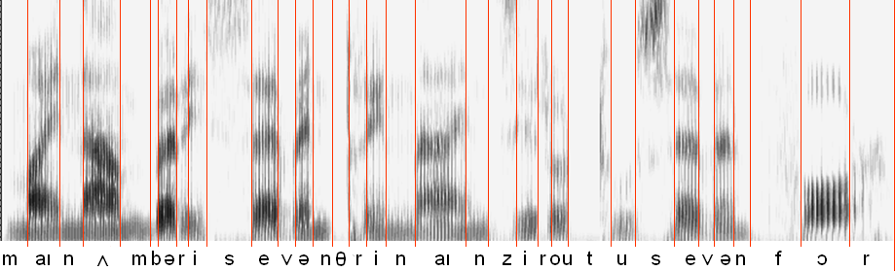
Length
Length is easy to measure but difficult to interpret
Again, length is relative
It is phonemic in many languages
Speech rate is not constant – slows down at the end of a sentence
<number>/34

Slide 17
Loudness
Loudness is easy to measure but difficult to interpret
Again, loudness is relative
<number>/34

Slide 18
Performance errors
Performance “errors” include
  Non-speech sounds
  Hesitations
  False starts, repetitions
Filtering implies handling at syntactic level or above
Some disfluencies are deliberate and have pragmatic effect – this is not something we can handle in the near future
<number>/34

Slide 19
Approaches to ASR
Template matching
Knowledge-based (or rule-based) approach
Statistical approach:
  Noisy channel model + machine learning
<number>/34

Slide 20
Template-based approach
Store examples of units (words, phonemes), then find the example that most closely fits the input
Extract features from speech signal, then it’s “just” a complex similarity matching problem, using solutions developed for all sorts of applications
OK for discrete utterances, and a single user
<number>/34

Slide 21
Template-based approach
Hard to distinguish very similar templates
And quickly degrades when input differs from templates
Therefore needs techniques to mitigate this degradation:
  More subtle matching techniques
  Multiple templates which are aggregated
Taken together, these suggested …
<number>/34

Slide 22
Rule-based approach
Use knowledge of phonetics and linguistics to guide search process
Templates are replaced by rules expressing everything (anything) that might help to decode:
  Phonetics, phonology, phonotactics
  Syntax
  Pragmatics
<number>/34

Slide 23
Rule-based approach
Typical approach is based on “blackboard” architecture:
  At each decision point, lay out the possibilities
  Apply rules to determine which sequences are permitted
Poor performance due to
  Difficulty to express rules
  Difficulty to make rules interact
  Difficulty to know how to improve the system
k
h
p
t
ʃ
tʃ
h
s
s
ʃ
i:
iə
ɪ
<number>/34

Slide 24
Identify individual phonemes
Identify words
Identify sentence structure and/or meaning
Interpret prosodic features (pitch, loudness, length)
<number>/34

Slide 25
Statistics-based approach
Can be seen as extension of template-based approach, using more powerful mathematical and statistical tools
Sometimes seen as “anti-linguistic” approach
  Fred Jelinek (IBM, 1988): “Every time I fire a linguist my system improves”
<number>/34

Slide 26
Statistics-based approach
Collect a large corpus of transcribed speech recordings
Train the computer to learn the correspondences (“machine learning”)
At run time, apply statistical processes to search through the space of all possible solutions, and pick the statistically most likely one
<number>/34

Slide 27
Machine learning
Acoustic and Lexical Models
  Analyse training data in terms of relevant features
  Learn from large amount of data different possibilities
    different phone sequences for a given word
    different combinations of elements of the speech signal for a given phone/phoneme
  Combine these into a Hidden Markov Model expressing the probabilities
<number>/34

Slide 28
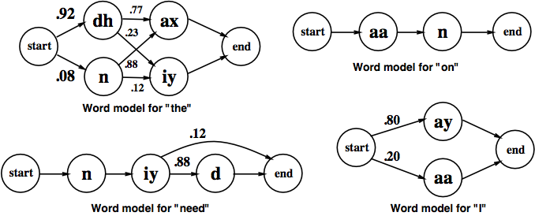
HMMs for some words
<number>/34

Slide 29
Language model
Models likelihood of word given previous word(s)
n-gram models:
  Build the model by calculating bigram or trigram probabilities from text training corpus
  Smoothing issues
<number>/34

Slide 30
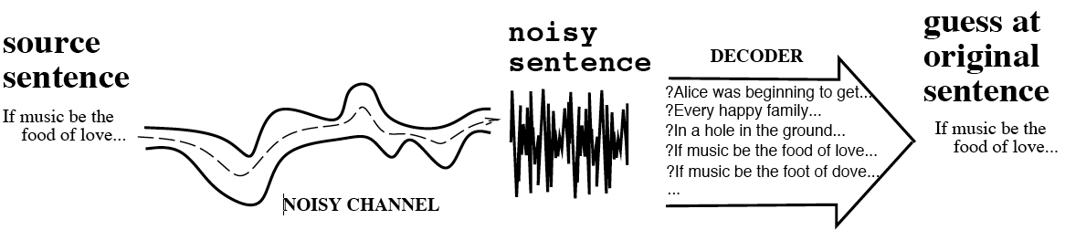
The Noisy Channel Model
Search through space of all possible sentences
Pick the one that is most probable given the waveform
<number>/34

Slide 31
The Noisy Channel Model
Use the acoustic model to give a set of likely phone sequences
Use the lexical and language models to judge which of these are likely to result in probable word sequences
The trick is having sophisticated algorithms to juggle the statistics
A bit like the rule-based approach except that it is all learned automatically from data
<number>/34

Slide 32
Evaluation
Funders have been very keen on competitive quantitative evaluation
Subjective evaluations are informative, but not cost-effective
For transcription tasks, word-error rate is popular (though can be misleading: all words are not equally important)
For task-based dialogues, other measures of understanding are needed
<number>/34

Slide 33
Comparing ASR systems
Factors include
  Speaking mode: isolated words vs continuous speech
  Speaking style: read vs spontaneous
  “Enrollment”: speaker (in)dependent
  Vocabulary size (small <20 … large > 20,000)
  Equipment: good quality noise-cancelling mic … telephone
  Size of training set (if appropriate) or rule set
  Recognition method
<number>/34

Slide 34
Remaining problems
Robustness – graceful degradation, not catastrophic failure
Portability – independence of computing platform
Adaptability – to changing conditions (different mic, background noise, new speaker, new task domain, new language even)
Language Modelling – is there a role for linguistics in improving the language models?
Confidence Measures – better methods to evaluate the absolute correctness of hypotheses.
Out-of-Vocabulary (OOV) Words – Systems must have some method of detecting OOV words, and dealing with them in a sensible way.
Spontaneous Speech – disfluencies (filled pauses, false starts, hesitations, ungrammatical constructions etc) remain a problem.
Prosody –Stress, intonation, and rhythm convey important information for word recognition and the user's intentions (e.g., sarcasm, anger)
Accent, dialect and mixed language – non-native speech is a huge problem, especially where code-switching is commonplace
<number>/34

